Slide 1

Enhancing Efficiency and Reducing Waste in Blister Packaging at Laurus Labs
-A DMAIC Approach

Slide 2

Role of Operations and Excellence Team
Order Division and Execution:
The Operations and Excellence team is responsible for dividing large orders into manageable batches.
These batches are executed over multiple days to optimize resource utilization and ensure consistent production flow.
Coordinating with different departments to ensure seamless integration of activities.
Elimination of Non-Value Added Activities:
Identifying and removing non-value-added activities to streamline the manufacturing process.
Implementing LEAN principles to reduce waste and enhance efficiency.
Continuously monitoring and improving processes to maintain high standards of operational excellence.

Slide 3
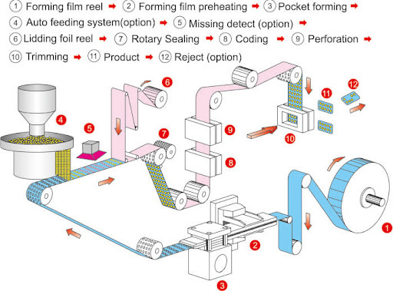
INTRODUCTION
Purpose of the Study:
To increase efficiency and reduce waste during blister packaging processes at Laurus Labs.
Objectives:
Identify key waste issues.
Propose effective solutions.
Ensure sustainable improvements through continuous monitoring.

Slide 4
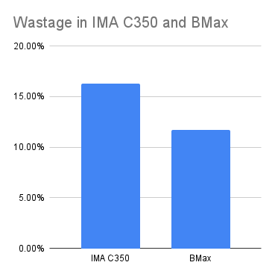
Measure Phase
Data Collection Methods:
Machine logs: Recording downtimes and errors.
Batch records: Tracking material usage and wastage.
Operator insights: Gaining insights into operational challenges.
Observations: Identifying inefficiencies in real-time.
Key Metrics:
Waste percentage
Frequency of power failures
Size of roll changeovers
Training duration for operators
Baseline Performance:
Waste rates: 16.32% (IMA C350), 11.71% (BMAX)
Power failures: Average of 2 incidents per day.

Slide 5
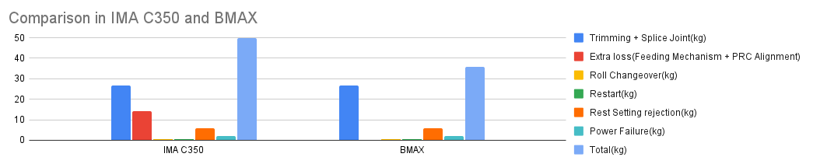
Analyze Phase
Waste Quantification:
Batch Size: 1,800,000 tablets.
Total Packing Material Required: 305.1 kg.
Wastage in IMA C350: 16.32%, translating to 49.79 kg per batch.
Wastage in BMAX: 11.71%, translating to 35.73 kg per batch.
Fixed Waste (Trimming and Splice Joints):
Constant Waste Across Both Machines: 26.8 kg.
Remaining Waste Calculation:
IMA C350: Total Waste - Fixed Waste = 49.79 kg - 26.8 kg = 22.99 kg.
BMAX: Total Waste - Fixed Waste = 35.73 kg - 26.8 kg = 8.93 kg.
Difference Due to Machine Issues:
Difference Between IMA C350 and BMAX: 22.99 kg - 8.93 kg = 14.06 kg.
Attributable to Feeding Mechanism and PRC Alignment Issues in IMA C350: 14.06 kg.

Slide 6
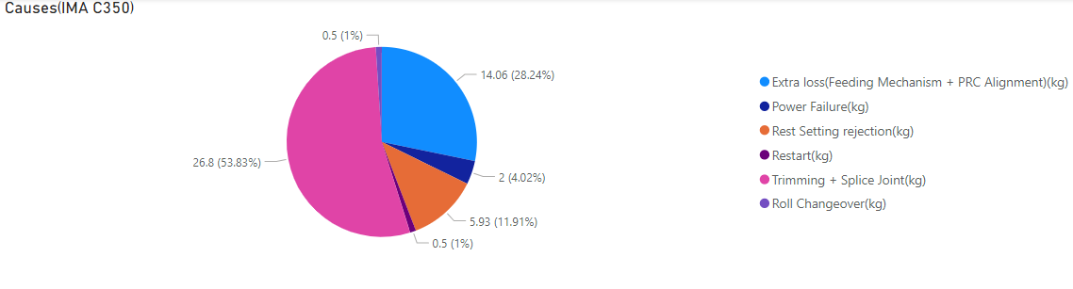
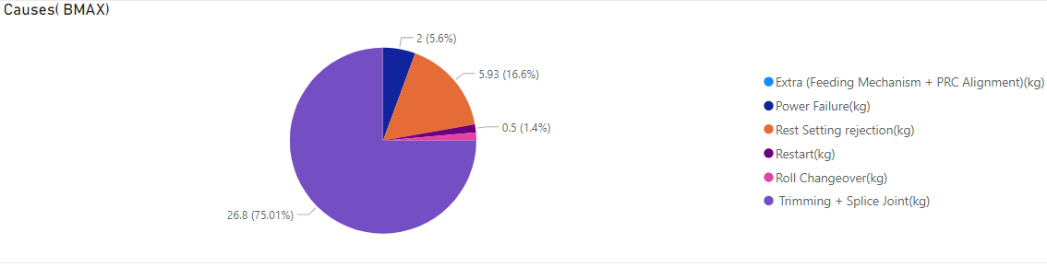
Analyze Phase
Root Cause Analysis:
Feeding Mechanism & PRC Alignment: Significant waste in IMA C350.
Power Failures: 2 kg of waste per batch.
Roll Changeover: 0.5 kg of waste per batch.
Restart Waste: 0.5 kg of waste per batch.
Incorrect Settings: 5.93 kg of waste per batch.

Slide 7
Improve Phase
Machine Enhancements:
Channel Feeding Mechanism and Pressure Sealing Roller Improvement:
Current Extra Waste: 14.06 kg
Implementation:
Replace drum feeding mechanism with channel feeding mechanism in IMA C350.
Aim: Reduce feeding mechanism and PRC alignment issues.
Pressure Sealing Roller Improvement:
Implementation:
Increase the lifetime and efficiency of pressure sealing rollers.
Aim: Reduce waste due to PRC alignment issues.
Training:
Extended Training Period:
Current Waste: 5.93 kg
Improved Waste: 3 kg
Implementation:
Extend operator training from 1-2 months to 6 months.
Aim: Enhance operator skills to minimize errors and improve efficiency.

Slide 8
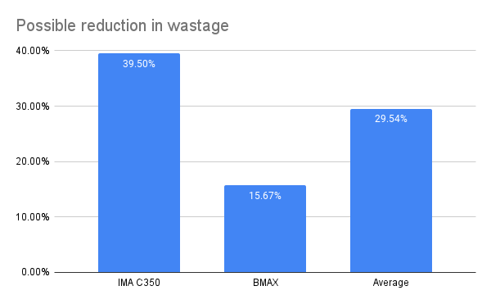
Improve Phase
Operational Improvements
UPS System:
Power Failure Mitigation:
Current Waste: 2 kg
Improved Waste: 0 kg
Implementation:
Install an Uninterruptible Power Supply (UPS) system.
Aim: Ensure continuous operation during power outages.
Roll Changeover:
Longer Roll Lengths:
Current Waste: 0.5 kg
Improved Waste: 0.33 kg
Implementation:
Increase roll length from 12 kg to 18 kg.
Aim: Reduce waste from roll changeovers.
Shift Coordination:
Improved Shift Management:
Current Waste: 0.5 kg
Improved Waste: 0 kg
Implementation:
Improve shift coordination to ensure seamless transitions.
Aim: Reduce waste during restarts.

Slide 9
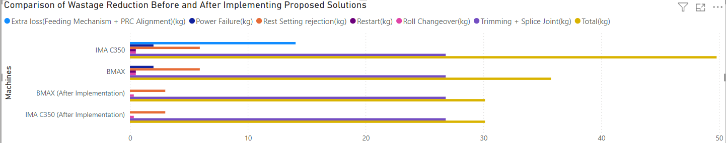
POSSIBLE COST REDUCTION(Assuming Rs650/kg)
IMA C350:
Current Cost: ₹32,344per batch (49.79*650).
New Waste Reduction: 19.66kg (from 49.79 kg to 30.13 kg).
New Cost: ₹19,584.50 per batch.
Savings per Batch: ₹12,759.5
BMAX:
Current Cost: ₹23,224.50 per batch.
New Waste Reduction: 5.6 kg (from 35.73 kg to 30.13 kg).
New Cost: ₹19,584.50 per batch.
Savings per Batch: ₹3,640

Slide 10

Control Phase
Monitoring Plan:
Regular collection and analysis of waste data.
Use control charts to monitor waste reduction progress.
Control Charts & KPIs:
Key Performance Indicators (KPIs) to track progress.
Establishment of control limits for acceptable waste levels.
SOPs:
Develop and implement standard operating procedures for consistent operations.
Training Programs:
Continuous training and retraining of operators.

Slide 11
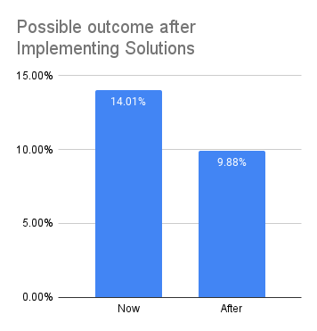
CONCLUSION
Summary of Findings:
Identified major waste contributors: feeding mechanism, PRC alignment, power failures, roll changeovers, restart waste, incorrect settings.
Impact on Operations:
Expected waste and cost reduction and efficiency improvements.
Enhanced operator skills and better machine performance.

Slide 12

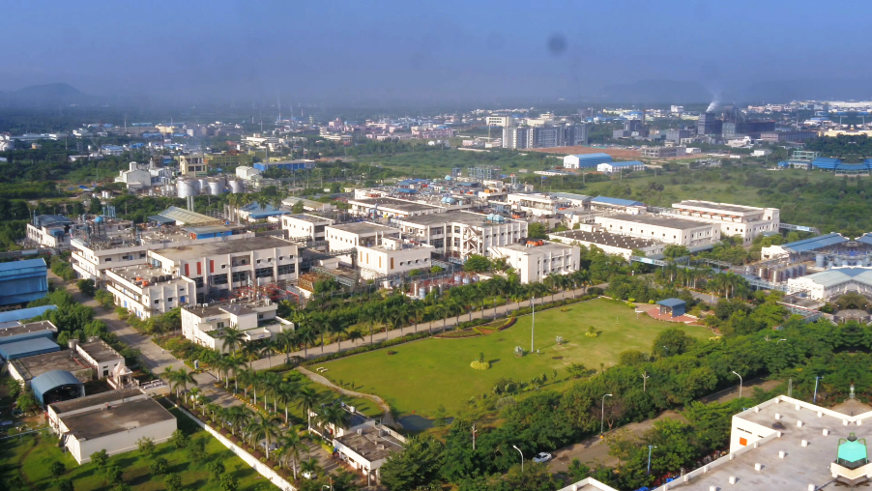

THANK YOU!
SUYASH SINHA
2022A5PS1447P

